Slide 1
Provisioning Site Collections
Speaker Name

Slide 3
Objective
After completing this lesson, you will:
Understand the default user interface for creating modern team sites and communication sites
Understand the settings that are available for managing site collection, subsite, and Microsoft 365 group creation
Understand how to provisioning modern site collections using PnP PowerShell module
Understand the concepts of provisioning modern site collections programmatically using SharePoint Online REST API
Notes:
Introduction
This lesson introduces you to the methods that are available for creating site collections in Microsoft 365 SharePoint Online
Objectives
After completing this lesson, you will be able to:Understand the default user interface for creating modern team sites and communication sites
Understand the settings that are available for managing site collection, subsite, and Microsoft 365 group creation
Understand how to provisioning modern site collections using PnP PowerShell module
Understand the concepts of provisioning modern site collections programmatically using SharePoint Online REST API
An introduction to the PnP Remote Provisioning framework

Slide 4
Provisioning Site Collections

Slide 5
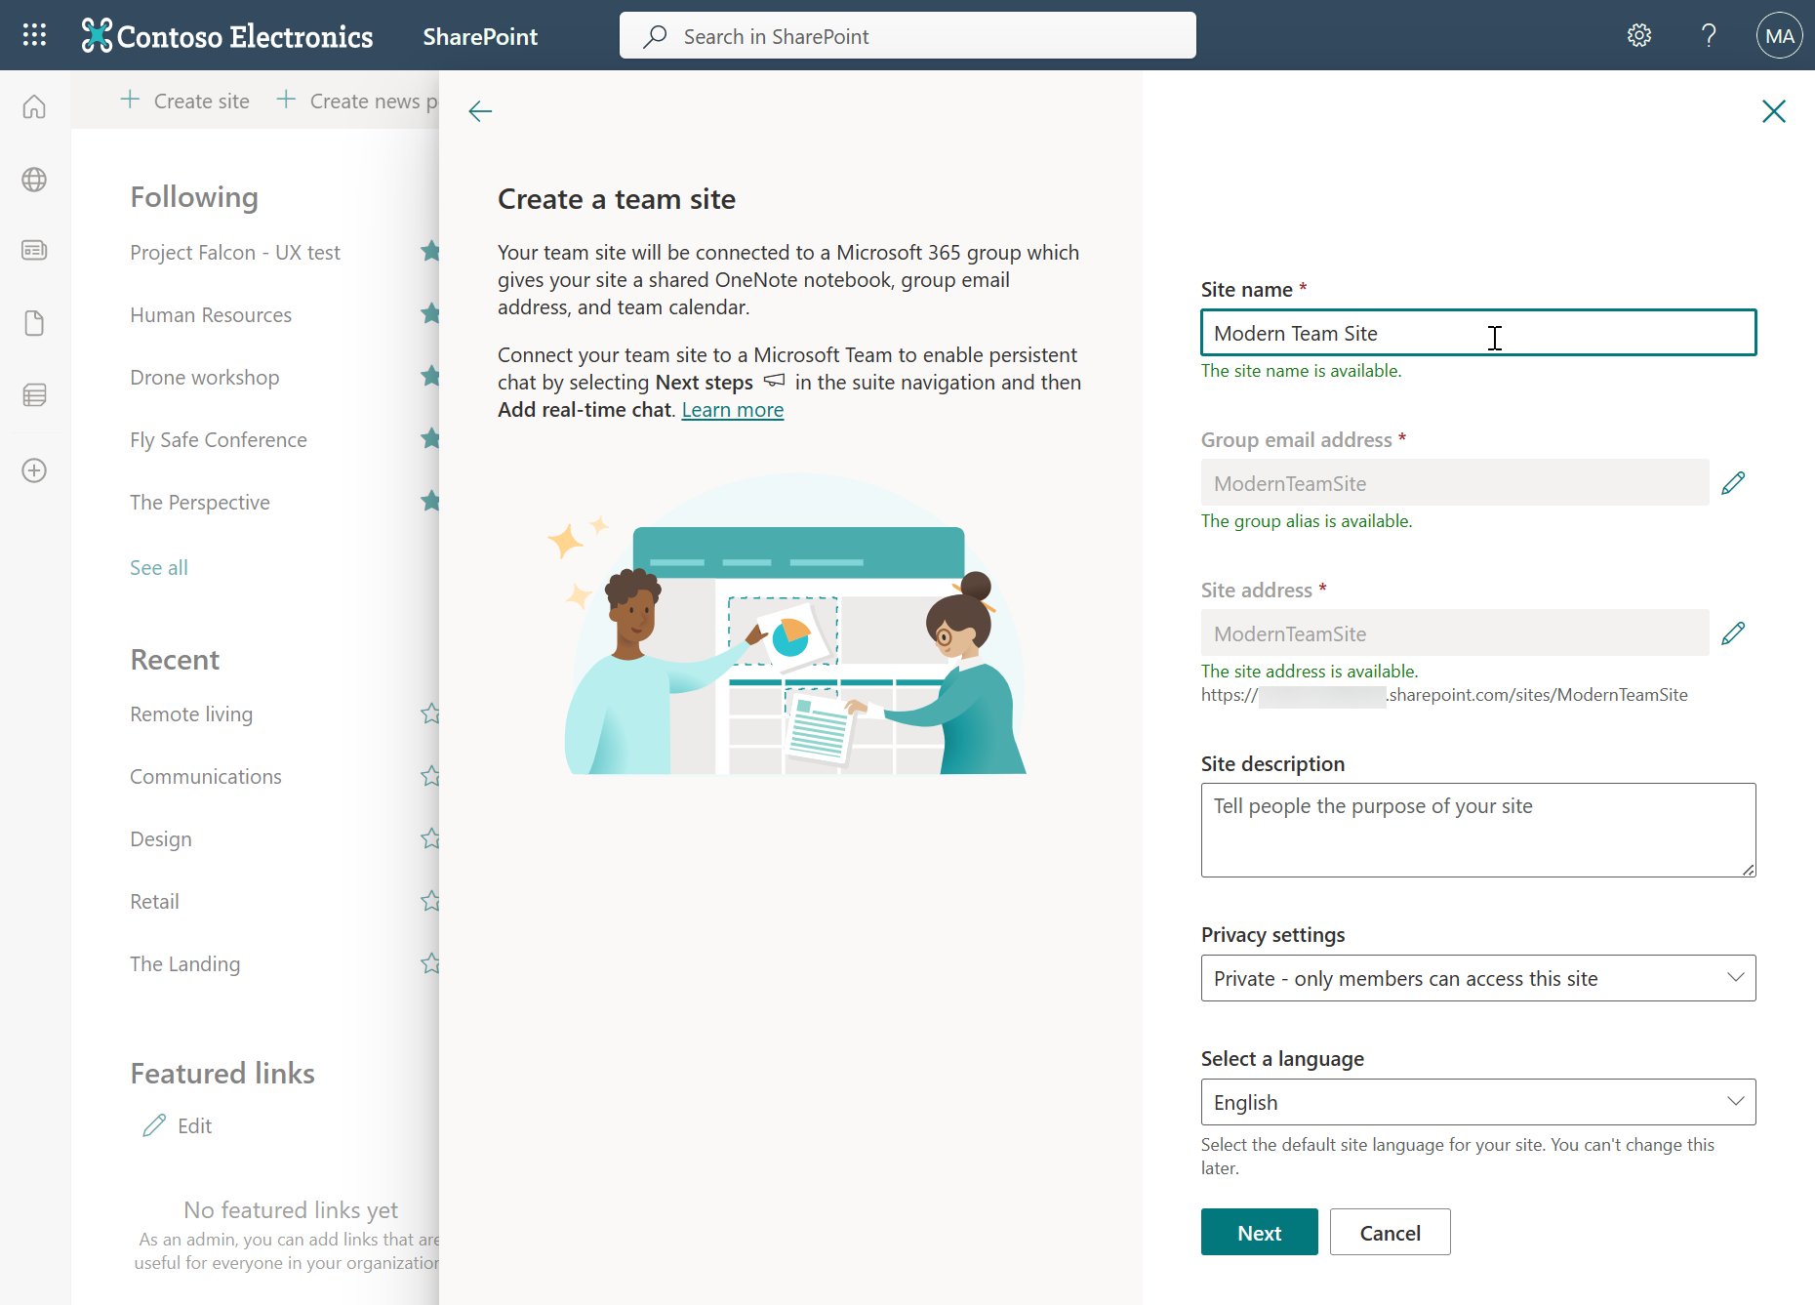
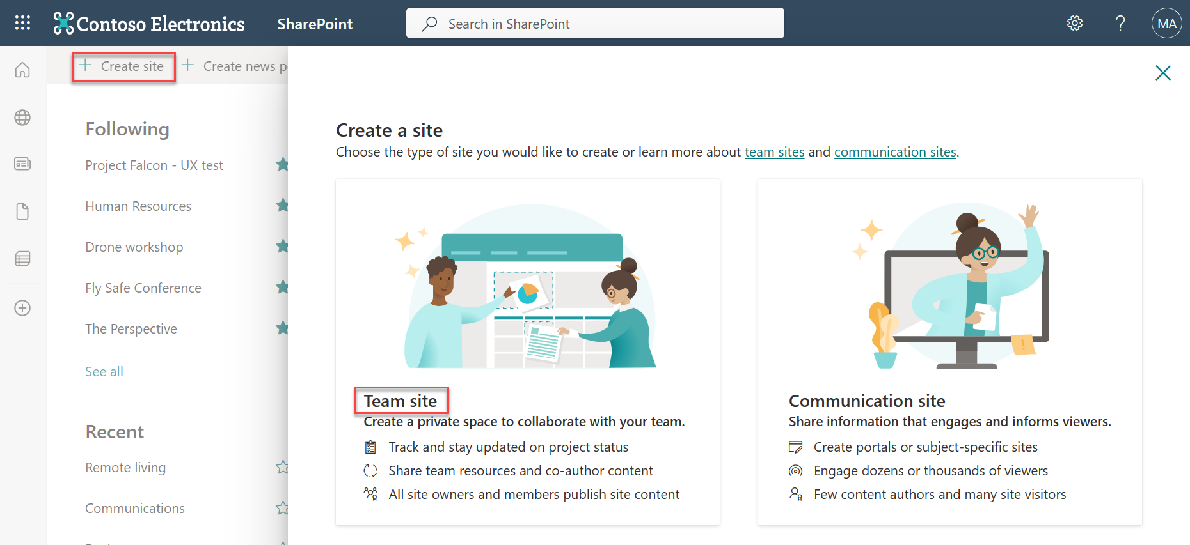
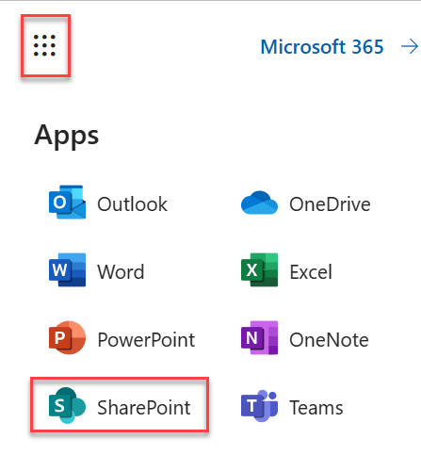
Modern Team site creation
By default, all users within the organization can create new modern team and communication sites from within SharePoint Home
Team Sites created using this method will be integrated with a Microsoft 365 Group
Communication sites are not connected with Microsoft 365 group

Slide 6
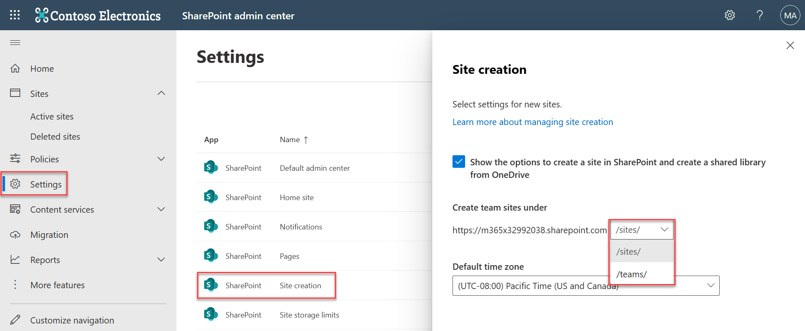
Manage site creation in SharePoint Online
As a SharePoint admin you can
Let your users create and administer their own SharePoint sites
Determine what kind of sites they can create
Specify the location of the sites.
Notes:
Its is recommended to turn off/hide SharePoint sub site creation which is aligned with Microsoft Direction. You can achieve this using classic admin settings page.
Classic admin setting Page should be used for additional options.

Slide 7
Allow only a select group of users to create groups
Control who can create Microsoft 365 Groups
Global Admins can control who can create modern team sites that are integrated with Microsoft 365 groups by controlling who can create Microsoft 365 Groups
Create a security group and add only the people who will be allowed to create Microsoft 365 Groups and teams in these apps. (This requires a subscription to Azure Active Directory (Azure AD) Premium.)
The administrator who configures the settings, and the members of the affected groups, must have Azure AD Premium licenses assigned to them.
Configurable using Azure Active Directory PowerShell for Graph:
$Setting["GroupCreationAllowedGroupId"] = (Get-AzureADGroup -SearchString "<Name of your security group>").objectid
Notes:
Manage who can create Microsoft 365 Groups
Microsoft 365 Admin Microsoft 365 Business Microsoft Planner Microsoft Teams
Last updated 11 June, 2018
Because it's so easy for users to create Microsoft 365 Groups, you aren't inundated with requests to create them on behalf of other people. Depending on your business, however, you might want to control who has the ability to create groups. Why do this?
This article explains how to disable the ability to create groups in all Microsoft 365 services that use groups:
Outlook
SharePoint
Yammer
Microsoft Teams: Both admins and users won't be able to create teams.
StaffHub: Both admins and managers won't be able to create teams.
Planner: Users won't be able to create a new plan in Planner web and mobile apps.
PowerBI
The best way to do this is to create a security group, and then only the people in that security group will be able to create Microsoft 365 Groups and teams in these apps. This article walks you through these steps.
To control who creates Microsoft 365 Groups, you use Windows PowerShell, which is a lot like typing commands at the C:\ prompt in the old DOS environment. If you've never used PowerShell, this task is a great introduction to using it. We walk you through what you need to do, step-by-step.
What you need to know before you begin
Doing the steps in this article requires a subscription to Azure Active Directory (Azure AD) Premium. The administrator who configures the settings, and the members of the affected groups, must have Azure AD Premium licenses assigned to them. For more information see Getting started with Azure Active Directory Premium.
Do not try to use the GA version - Azure Active Directory PowerShell for Graph - to perform the steps in this article. It won't work.
The PowerShell commands in this article only change who can create Microsoft 365 Groups. They won't affect the rest of your Microsoft 365 environment.
You apply the steps in this article only once in your organization, for one security group. If you try to applying them again for another security group, you'll get an error that looks like this:
A conflicting object with one or more of the specified property values is present in the directory.
The steps in this article don't prevent members of the following roles from creating Microsoft 365 Groups in the Microsoft 365 admin center. However, it does prevent them from creating Microsoft 365 Groups from the apps and it prevents them from creating teams (because you can't create teams in the Microsoft 365 admin center).
Microsoft 365 Global admins
Mailbox Administrator
Partner Tier1 Support
Partner Tier2 Support
Directory Writers
If you're a member of one of these roles, you can create Microsoft 365 Groups for restricted users, and then assign the user as the owner of the group.
It's important that you use a security group - as described in Step 1 of this article - to restrict who can create Microsoft 365 groups. Don't try to use an Microsoft 365 Group for this. If you try to use an Microsoft 365 Group, members won't be able to create a group from SharePoint because it checks for a security group.
Setting Set-MSOLCompanySettings -UsersPermissionToCreateGroupsEnabled $True only enables permissions for users to create Security groups, not Microsoft 365 groups. For more information about this cmdlet, see Set-Msolcompanysettings.
Let's say you do the steps in this article and give some people the ability to create Microsoft 365 Groups. But for some reason they still can't create an Microsoft 365 group using Outlook. Check that they aren't being blocked through their OWA mailbox policy. It provides additional controls to block the creation of Microsoft 365 groups using Outlook.
Install the preview version of the Azure Active Directory PowerShell for Graph
IMPORTANT: You cannot install both the preview and GA versions on the same computer at the same time.
As a best practice, we recommend always staying current: uninstall the old AzureADPreview or old AzureAD version and get the latest one.
For the additional configuration steps, see https://support.office.com/en-us/article/Manage-who-can-create-Office-365-Groups-4c46c8cb-17d0-44b5-9776-005fced8e618

Slide 8
Provision a "modern" team site by using PnP PowerShell
You can create "modern" sites by using PnP PowerShell module for SharePoint Online
The New-PnPSite cmdlet creates a new site collection for the current tenant.
Currently only 'modern' sites like Communication Site and the Modern Team Site are supported.
If you want to create a classic site, use New-PnPTenantSite.
This script creates a "modern" team site the is integrated with a Microsoft 365 group
# Connect to SharePoint Online
# This command will prompt the sign-in UI to authenticate
Connect-PnPOnline "https://[tenant].sharepoint.com/"
# Create the new "modern" team site
$teamSiteUrl = New-PnPSite -Type TeamSite -Title "displayName" -Alias "mymodernteamsite" -Description "description" -IsPublic -Classification "classification"
# Connect to the modern site using PnP PowerShell SP cmdlets
# Since we are connecting the new to SP side, credentials will be asked
Connect-PnPOnline $teamSiteUrl
Notes:
For more information on Provisioning "modern" team sites programmatically
See https://docs.microsoft.com/en-us/sharepoint/dev/solution-guidance/modern-experience-customizations-provisioning-sites

Slide 9
Provision a "modern" team site not integrated with an Microsoft 365 group
You can create "modern" sites using the SharePoint Online management shell
Use the STS#3 template
This will provision a new modern team site that is not integrated with an Microsoft 365 group
import-module SharePointPnPpowershellOnline
connect-sposervice
$Url = "https://contoso.sharepoint.com/teams/teamsite"
$template = STS#3
$title = "Team Site"
$quota = 1000
$owner = "admin@contoso.onmicrosoft.com"
New-SPOSite –url $URL –template $template –title $title –owner $owner –storagequota $quota
Notes:
For more information on Provisioning "modern" team sites programmatically
See https://docs.microsoft.com/en-us/sharepoint/dev/solution-guidance/modern-experience-customizations-provisioning-sites

Slide 10
Provision a "modern" team site programmatically via SharePoint Online REST API
"Modern" team sites can be created programmatically by using a REST API provided by SharePoint Online
To provision a "modern" team site via REST, make a POST request to the Microsoft Graph "groups" endpoint: https://graph.microsoft.com/v1.0/groups
POST https://graph.microsoft.com/v1.0/groups
Content-type: application/json
Content-length: 200
{
"description": "description",
"displayName": "My modern team site",
"groupTypes": [
"Unified"
],
"mailEnabled": true,
"mailNickname": "mymodernteamsite",
"securityEnabled": false
}
Notes:
The example in this slide would create an Microsoft 365 group and an associated "modern" team site with a URL of https://[tenant].sharepoint.com/sites/mymodernteamsite
For more information on Provisioning "modern" team sites programmatically
See https://docs.microsoft.com/en-us/sharepoint/dev/solution-guidance/modern-experience-customizations-provisioning-sites

Slide 11
Knowledge Check
True/False: By default, users can create new modern team site collections connected to Microsoft 365 group, and communication site collections?
True
What are the two managed paths available in SharePoint Online?
/sites and /teams
Which PowerShell modules can be used to provision modern team sites?
The SharePoint Online PnP PowerShell module and its New-PnPSite command to provision an Microsoft 365 group integrated site
The SharePoint Online Management shell and its New-SPOSite command to provision site that is not integrated with an Microsoft 365 group (must specify template.. ie STS#3 )
Notes:
1. True/False: By default users have the ability to create new modern team site collections and communication site collections?
Ture
2. What are the two managed paths available in SharePoint Online?
/sites and /teams
3. Which PowerShell module is used to provision modern team sites?
The SharePoint Online PnP PowerShell module and its New-PnPSite command

Slide 12
Summary
In this lesson, you learned about:
The default user interface for creating modern team sites and communication sites
The settings for managing site collection, subsite, and Microsoft 365 group creation
Provisioning modern site collections using PnP PowerShell module
Provisioning modern site collections programmatically using SharePoint Online REST API

